Slide 1

ECEN 3593-001 Computer Organization
Lecture #13
15 February 2021

Slide 2


Agenda
Class Announcements
Phase 4 Schematic Tool Demo
Pipelined Processor

Slide 3
Class Announcements
Reading for the week
“Computer Organization and Design, The Hardware / Software Interface, RISC-V edition,” by David Patterson and John Hennessy
ISBN 978-0-12-812275-4
Appendix A – “The Basics of Logic Design”
pages A-1 through A-37 (sections A.1 through A.5)

Slide 4
Class Announcements
Wednesday is Wellness Day – feel free to take a break and recharge
No class session, but Office Hours are available by request

Slide 5
Class Announcements
Phase 4 Target Date Sunday, February 21 at 10:00 PM
Homework #2 due Thursday, February 18 at 10:00 PM
Phase 3 in the deduction period – 2% as of today
Deduction reduced – 2%/day until Friday, then 5%/day
Read the document carefully – there are several ways to lose points
Phase 5 will be posted Wednesday evening.
Target Date Sunday, February 28 at 10:00 PM

Slide 6
Executing an Instruction (ME Stage)
PC → instruction memory, fetch instruction
Register numbers → register file, read registers
Depending on instruction class
Use ALU to calculate
Arithmetic result
Memory address for load/store
Branch target address
Access data memory for load/store
Update PC ← target address or PC + 4
Update Register File

Slide 7
Memory (ME) Stage - Memory
ALU output is the pipeline register
Provide the DM address
Provide the DM write data
Read or write memory data
Memory (MEM/ME)
ALU
addr
dout
Data Memory
memrd
din
memwr
ctrl5
ctrl6

Slide 8
Executing an Instruction (ME Stage)
PC → instruction memory, fetch instruction
Register numbers → register file, read registers
Depending on instruction class
Use ALU to calculate
Arithmetic result
Memory address for load/store
Branch target address
Access data memory for load/store
Update PC ← target address or PC + 4
Update Register File

Slide 9
Memory (ME) Stage - Branch
ctrl1
Zero output is the pipeline register
Add branch offset to PC
Zero selects the next PC input (branch or not)
MUX
ADD
zero
ALU
PC

Slide 10
Executing an Instruction (WB Stage)
PC → instruction memory, fetch instruction
Register numbers → register file, read registers
Depending on instruction class
Use ALU to calculate
Arithmetic result
Memory address for load/store
Branch target address
Access data memory for load/store
Update PC ← target address or PC + 4
Update Register File

Slide 11
Writeback (WB) Stage
Memory output is the pipeline register
Mux selects RF input – memory or ALU
Data written back to Register File
ctrl2
MUX
din
Register File
rd
addr
dout
dout1
rs1
dout2
Data Memory
Writeback (WB)
rs2
regwr
memrd
din
memwr

Slide 12
Phase 4
New #phase4 channel in Slack
Phase 4 involves building the schematic of a subset of RISC-V which executes 2 instructions (ADD and ADDI)
Schematics are drawn using app.diagrams.net in a Browser
The result is the standardname4.xml file
Submit by sending me a DM in Slack with standardname4.xml attached

Slide 13
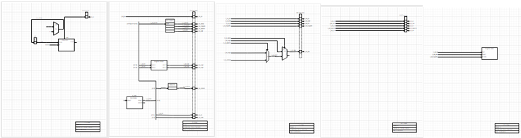
Schematics
IF
ID
EX
ME
WB

Slide 14
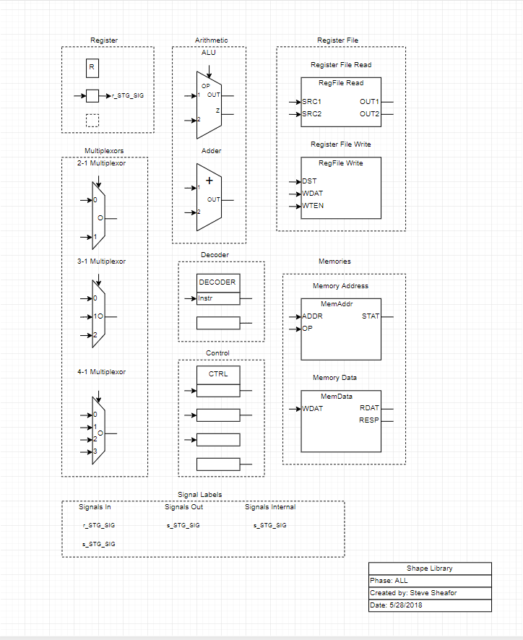
Component Library
Copy components from here to the other pages
Connect components using “signals” – input, output and internal
Label all signals
Distinguish “signals” and “registers”

Slide 15
Schematic Demonstration
Application is app.diagrams.net
Incorrectly listed as app.diagram.net in the Phase 4 document

Slide 16
Developing a 32-bit ALU
We will step through the process of designing the internals of an ALU
This material is in Appendix A of the textbook

Slide 17
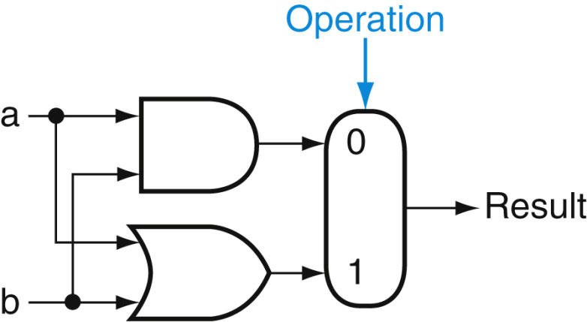
Developing a 32-bit ALU
A 1-bit logical unit to calculate AND if operation = 0 and OR if operation = 1

Slide 18
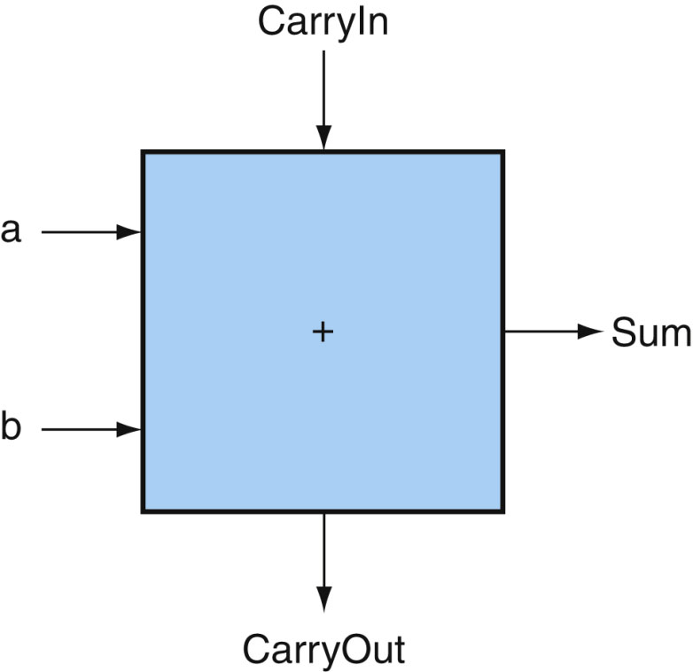
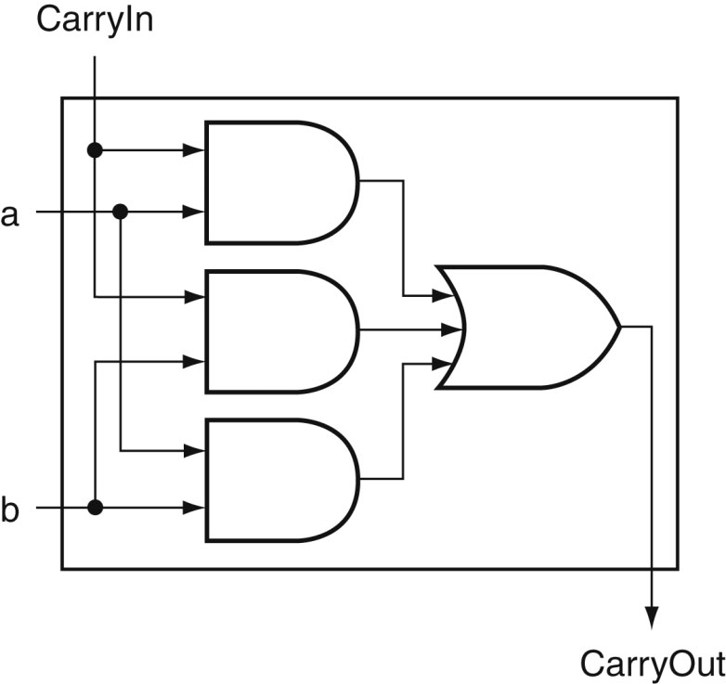
Developing a 32-bit ALU
Next we need a full bit adder
Sum = a ^ b
Includes a CarryIn bit from the previous 1-bit adder and CarryOut bit for the next

Slide 19
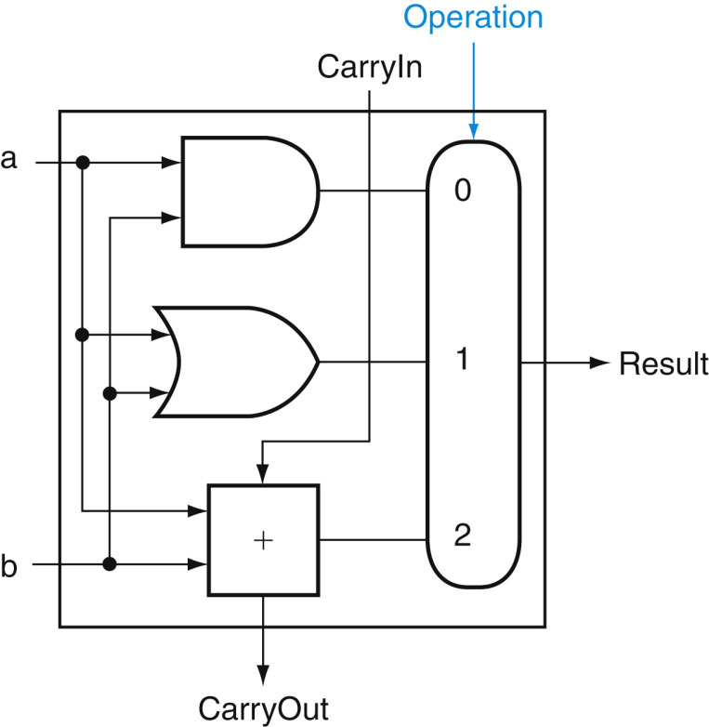
Developing a 32-bit ALU
Now we have an ALU that can AND, OR, and ADD whose output is specified by the control lines, Operation
Operation = 0b00, AND
Operation = 0b01, OR
Operation = 0b10, ADD

Slide 20
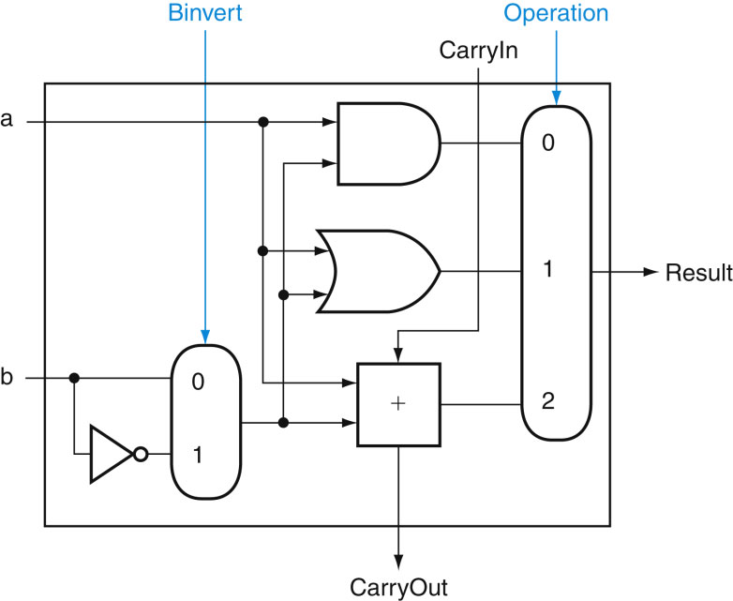
Developing a 32-bit ALU
Now we need subtraction
By asserting Binvert and in the least significant bit set CarryIn, we have 2s complement substraction
Control bits: Binvert, Operation, CarryIn
Op = 0b0000, AND
Op = 0b0010, OR
Op = 0b0100, ADD
Op = 0b1101, Sub

Slide 21
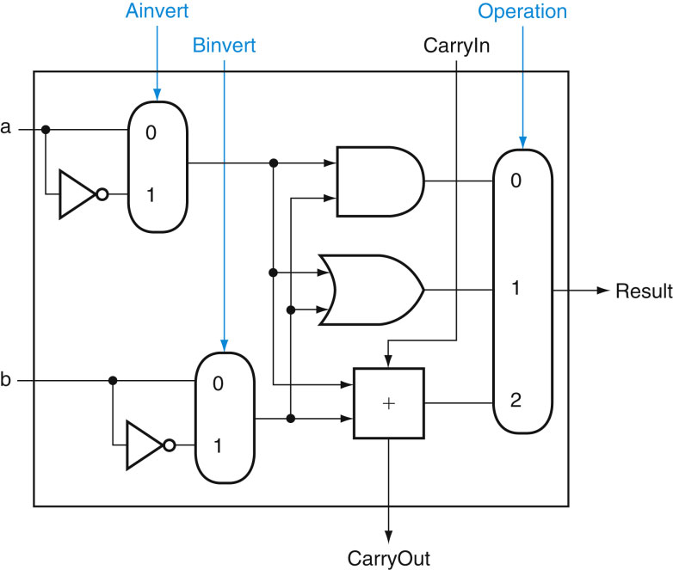
Developing a 32-bit ALU
Now, we could implement a NOR instruction by providing both Ainvert and Binvert
Control bits: Ainvert, Binvert, Operation
0b0000, AND
0b1100, NOR, not defined per the ISA
0b0001, OR
0b0010, ADD
0b0110, Sub (a – b)
0b1101, NAND, not defined per the ISA
0b1010, sub (b – a), not defined per the ISA

Slide 22
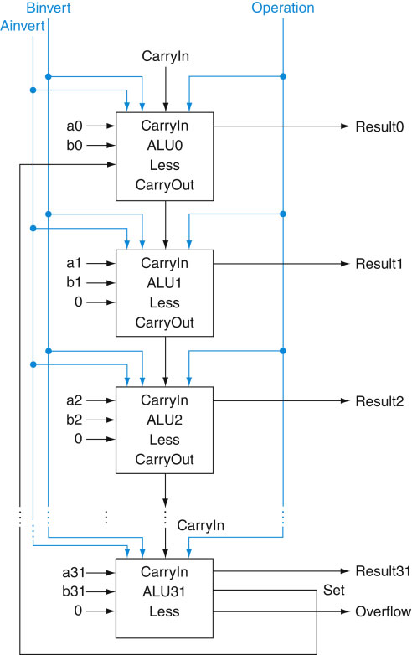
Developing a 32-bit ALU
Here is what the 32-bit Carry flow through ALU would look like
Set is the sign of the output (Result31) but is only used in some cases – when? (Poll)
SLT
Why do we have SLT and not SGT? (Poll)

Slide 23
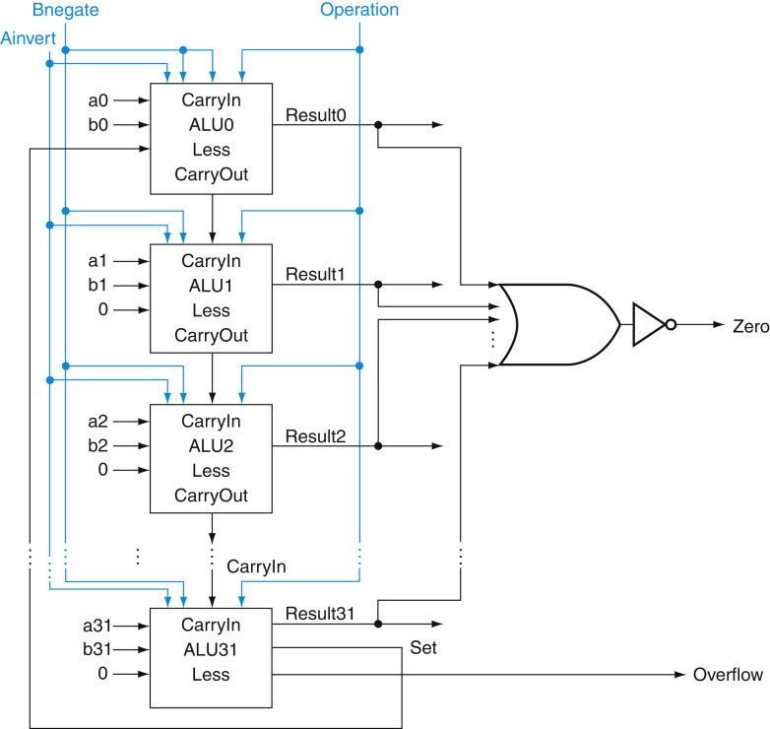
Developing a 32-bit ALU
By NORing all the outputs, the subtraction of registers a and b can be used to branch on equal
Equal numbers will equal 0, not equal numbers would be a 1

Slide 24
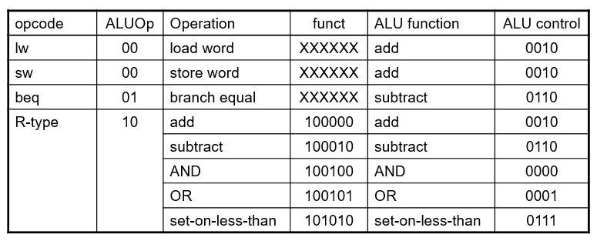
Developing a 32-bit ALU
Note arithmetic operations such as loads, stores, and beq use the ALU and must map into the ALU control lines

